Slide 1
Your First Express Web Application

Slide 2
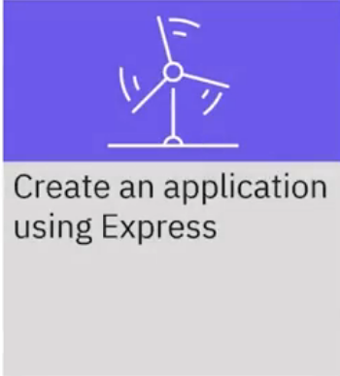
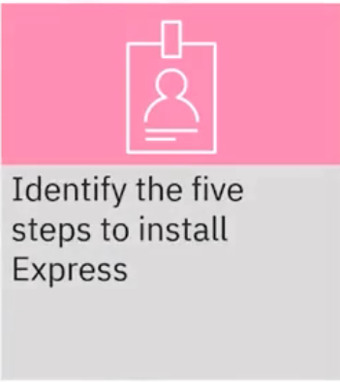
What you will learn

Slide 3
How Express works
Declare Express as a dependency in the package manifest of a Node.js project
Run the npm command to download any missing modules
Import the Express module and create an Express application
Create a new route handler
Start an HTTP server on a given port number
1 Declare
2 Install
3 Require
4 create
5 Start

Slide 4
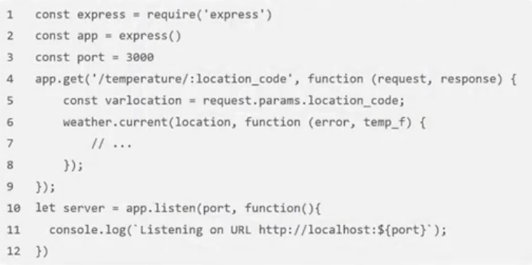
Your first Express program
• Run the npm install command
• Create a mynodeserver.js file
2 Install

Slide 5
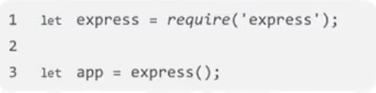
Step 3: Import the module
• Create an instance of the app object from the
Express web application framework
3 Require

Slide 6
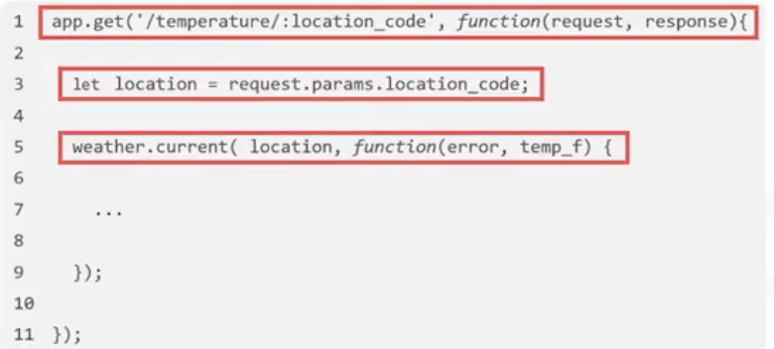
Step 4: Create new route handler
• To handle web application requests, map an HTTP
method and a web resource path to a JavaScript
function
4 create
• Listen to incoming HTTP GET requests, which request to the
/temperature resource path
• Run the weather.current
function with a location parameter
taken from the resource path

Slide 7
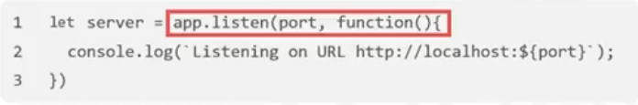

Step 5: Start HTTP server on port
• Call app.listen to create a web server object
(instance) that listens to incoming requests on the
specified port
5 Start

Slide 8
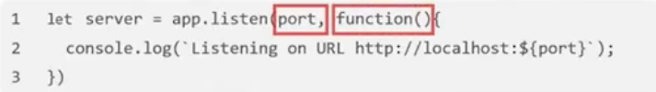
Step 5: Start HTTP server on port
• Example: the app listens to incoming requests on
port 8080
• The second parameter defines an anonymous
function that the Express framework calls when it
creates an instance of the server object
5 Start

Slide 9
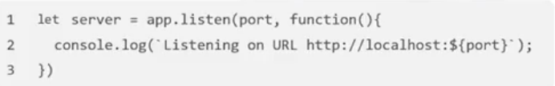

Step 5: Start HTTP server on port
• Enter http://localhost:8080/temperature/KSFO in a
browser and get the result
5 Start

Slide 10
Recap
In this video, you learned that:
• When you declare Express as a dependency in your Node.js
project, you can create your first Express application
• To install Express, there are five steps:
Declare Express as a dependency in the package manifest of a
Node.js project
Run the npm command to download any missing modules
Import the Express module and create an Express application
Create a new route handler
Start an HTTP server on a given port number

